Slide 1
MoteNN: Memory Optimization via Fine-grained Scheduling for Deep Neural Networks on Tiny Devices
Renze Chen¹, Zijian Ding², Size Zheng¹, Meng Li¹, Yun Liang¹
¹Peking University
²University of California, Los Angeles
Notes:
Hello, everyone. I'm Renze Chen. I'm glad to present our work MoteNN: Memory Optimization via Fine-grained Scheduling for Deep Neural Networks on Tiny Devices

Slide 2
Deep Neural Network (DNN) Deployment Becoming “Tiny"
Cloud AI
Mobile AI
Tiny AI
Notes:
Over the years, DNN have been going smaller. With the efforts of model compression and neural architecture search, people are able to migrate DNN deployment from expensive cloud data-centers to more accessible mobile laptops or smartphones. And in the next step, DNN will be commonly deployed on tiny devices like Micro-controllers.

Slide 3
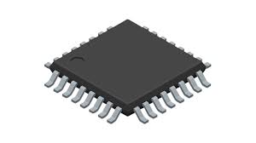
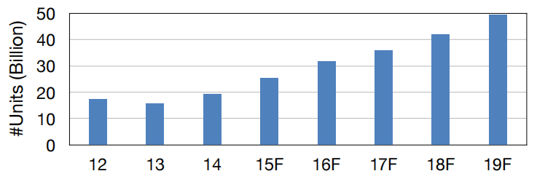
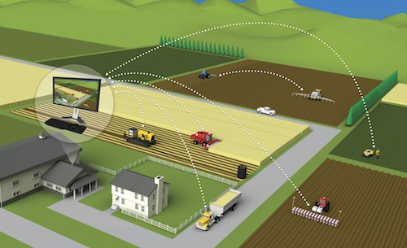
The Era of AIoT on Tiny Devices
Low-cost, low-power
Rapid growth
Wide applications
Smart Retail
Personalized Healthcare
Precision Agriculture
Smart Home
https://hanlab18.mit.edu/projects/tinyml/mcunet/assets/MCUNet-slides.pdf
Notes:
Tiny devices boast low cost and low power consumption, making them ubiquitous in edge scenarios such as IoT. Currently, billions of tiny devices are deployed worldwide. Meanwhile, the deployment of DNN on tiny devices is also widespread across various domains, including smart retail, personalized healthcare, precision agriculture, and smart homes.

Slide 4
Challenge: Small Memory Capacity
 | Cloud AI | Mobile AI | Tiny AI
Memory (Activation) | 40GB | 16GB | 512KB
Memory (Weights) | 40GB | 16GB | /
Storage (Weights) | ~TB/PB | 512GB | ~MB
32768x smaller
Reduce peak memory usage of activation to fit in memory is important!
81920x smaller
Notes:
However, deploying DNNs on tiny devices poses challenges, mainly due to their limited memory. Cloud and mobile devices typically boast memory capacities ranging from several to tens of gigabytes for storing activation and weight tensors. In contrast, tiny devices have only hundreds of kilobytes to a few megabytes of memory, four orders of magnitude less. Tiny devices usually feature fast interfaces for reading read-only data from flash storage, thus weight tensors are generally kept in flash storage instead of memory. Thus, reducing the peak memory usage of activation tensors to fit in device memory becomes crucial for successfully deploying DNNs on tiny devices.

Slide 5
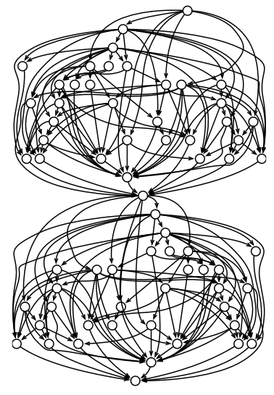
Causes of Large Memory Footprint of Activation
Long Lifetimes of Tensors
Many tensors should reside in memory for future reuse
Examples: NASNet, RandWire, AmoebaNet, DARTS, …
Large Sizes of Tensors
Tensors with large sizes occupies large memory.
Examples: 224x224 input image resolution, 512 input sequence length, …
Notes:
Model quantization and pruning primarily focus on reducing the memory usage of model weights, but they cannot further optimize the memory consumption of activation. To address the high memory footprint of activation, we need to identify its causes. First, some tensors have long lifetimes and should reside in memory until utilized by future computations. Such scenarios are common in complicated DNNs like NAS networks, including NAS-Net, Rand-Wire, and DARTS. Second, some tensors have large sizes, inherently demanding substantial memory space. For example, the high-resolution images in vision models and long token sequences in language models.

Slide 6
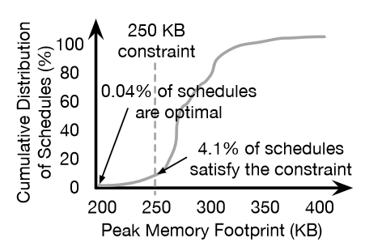
Scheduling-based Methods
Works like Serenity and HMCOS schedule the operator execution order to manage tensor lifetimes to optimize peak memory usage of activation.
Peak-mem=4
Peak-mem=3
A
A
A
A
A
B
B
B
B
B
C
C
C
D
D
D
D
C
D
C
E
E
E
E
E
[1]
[1]
F
F
F
F
F
Time
Time
[1] Ordering Chaos: Memory-Aware Scheduling of Irregularly Wired Neural Networks for Edge Devices
Notes:
Works like Serenity and HMCOS schedule the operator execution order to manage tensor lifetimes to optimize peak memory usage of activation. For instance, the DNN on the left originally has a peak memory of 4 with default execution order, but after proper scheduling, peak memory reduces to 3. These scheduling-based methods explore an vast search space of all valid topological orderings in a DNN graph to find the optimal schedules, which occupy less than 1% of the entire search space.

Slide 7
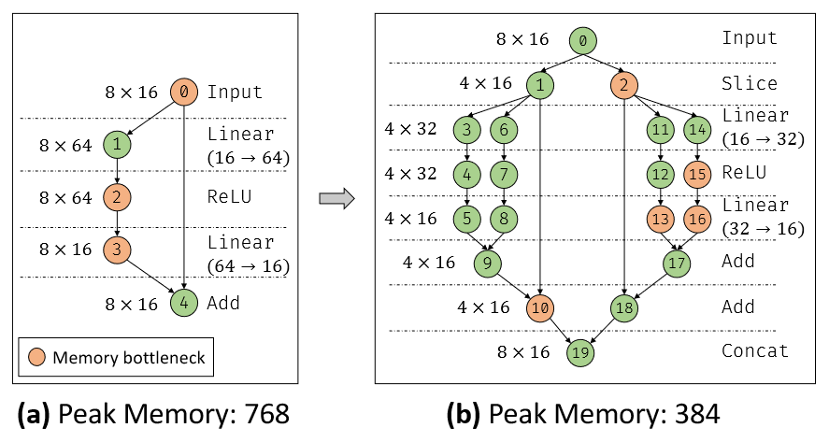
Observation: Make the Graph Fine-grained
We can further optimize the peak memory greatly by partitioning operators and scheduling the fine-grained graph
PS: "Memory bottleneck" refers to the tensor that contributes to the peak memory usage.
Notes:
However, scheduling-based methods only affect tensor lifetimes without changing their sizes, thus its capability for memory optimization is limited. We find that make the graph finer-grained by partitioning some operators into smaller ones and schedule the fine-grained graph can further reduce the memory usage. For example, Figure A shows that when we schedule the graph coarsely, we can optimize peak memory usage to at most 768. But if we enable more fine-grained scheduling, as shown in Figure B, we can reduce peak memory usage to 384.

Slide 8
Latency Overhead of Graph Partitioning is Tolerable
The overhead of graph/operators partitioning may come from two aspects
More kernel launches due to more operators
Less kernel efficiency (parallelism & locality) due to smaller shapes
Launching a kernel in MCU just involves calling a function with little overhead
Unlike GPU with massive host-device communications to launch a kernel.
The efficiency of kernel in MCU is mainly determined by the register-level micro-kernel shapes due to MCU’s simple execution/memory hierarchy.
The micro-kernel shapes are generally much smaller than operator shapes.
Notes:
Partitioning operators into smaller ones and making the graph fine-grained may introduce some latency overhead. The overhead mainly comes from two aspects: more kernel launches due to more operators, and less kernel execution efficiency due to smaller shapes. However, on tiny devices like micro-controllers, launching a kernel just involves calling a function with little overhead unlike the massive host-device communication overhead of GPU kernel launch; and the efficiency of kernel is mainly determined by the register-level micro-kernel's shape due to simple execution/memory hierarchy, where the micro-kernels shapes are often much smaller than the operator shapes. Therefore, the overhead of fine-grained graph can be tolerable on tiny devices.

Slide 9
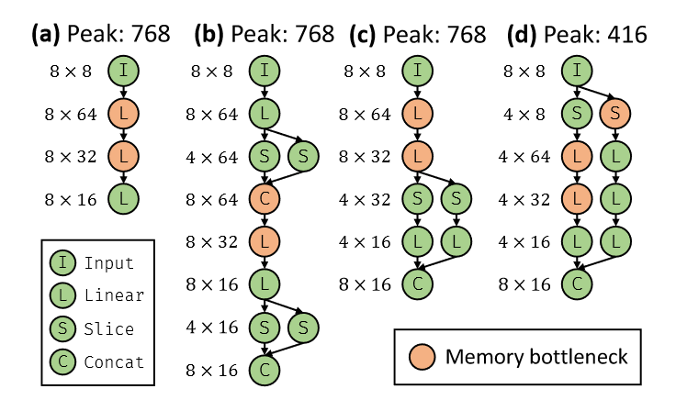
Insight-1
It is inefficient to consider the operator partition separately for each operator
Partition the two operators cannot improve peak memory usage.
Notes:
To optimize the peak memory usage via fine-grained scheduling, we have two insights. First, It is inefficient to consider the operator partition separately for each operator. Partitioning separately will introduce much redundancy and is hard to model the connections among operators. For instance, in Figure B, splitting the two Linear operators separately in Figure A has no impact on the peak memory. We need to consider the partition and scheduling of operators at graph level.

Slide 10
Insight-2
It is important to focus on memory bottlenecks
Partition non-memory-bottleneck cannot improve peak memory usage
partition memory-bottleneck improve peak memory usage
PS: "Memory bottleneck" refers to the tensor that contributes to the peak memory usage.
Notes:
Second, it is important to focus on memory bottlenecks, that is, the tensors contributing to peak memory usage. Only partitioning memory bottlenecks tensors can optimize peak memory. For instance, the tensors of size 8 times 32 and 8 times 64 are memory bottlenecks in Figure A. The partition of non-bottleneck tensors in Figure C doesn’t impact the peak memory. In contrast, Figure D partitions the bottlenecks of Figure A and greatly reduces the peak memory.

Slide 11
Axis Connecting Graph (ACG)
W_{Q}
X
W_{K}
W_{V}
W_{Q}
a
d
h
X
b
s
h
W_{K}
a
d
h
W_{V}
a
d
h
batch
attn-head
query-seq
MatMul
Q
K
V
Q
b
a
s
d
h
K
b
a
s
d
h
V
b
a
s
d
h
b
a
a
a
s
ACG
b
b
b
a
a
a
s
Batch MatMul
S
S
b
a
s
s
d
Some
Connected Components
b
a
s
Softmax
P
P
b
a
s
s
b
a
s
b
a
a
s
O
W_{Y}
Batch MatMul
O
O
W_{Y}
O
b
a
s
d
s
h
a
d
W_{Y}
b
a
s
d
h
a
d
W_{Y}
Axis Mappings
b
a
s
$$Y\left[b,s,h\right]=\sum_{a,d}{O\left[b,a,s,d\right]∗W_{Y}[h,a,d]}$$
Y
MatMul
Y
MatMul
Y
Y
b
s
h
a
d
b
s
h
a
d
b: batch-size
s: seq-length
h: hidden-size
a: #attn-heads
d: head-size
spatial axis
reduce axis
Notes:
To consider the partition of operators at graph level as insight-1 indicates, we define the Axis Connecting Graph or ACG. This can be derived from the axis mappings between adjacent operators. For instance, there's an operator Y, and based on its tensor expression we can derive the axis mappings, where solid squares denote spatial axes and hollow squares represent reduction axes. We can similarly build axis mappings for each operator in a sub-graph, thus constructing a Axis Connecting Graph. The connected components within the ACG can serve as the graph-level axis to perform graph partition.

Slide 12
Graph Partition with Axis Connecting Graph (ACG)
Partition Scheme
...
...
$$A$$
0
0
b
S
0
S
b
h₁
h₁
0
$$p=(S,A,n)$$
3
$$S$$
$$S_{1}$$
$$S_{2}$$
3
b
3₁
3₂
b
h₁
1
h₁
1
h₂
3
1
h₂
h₁
h₁
1
4
$S$: Sub-graph to split
$A$: ACG for partition
$n$: Number of partitions
4
2
2
4₁
S
2
S
4₂
b
2
4
b
h₂
h₂
h₁
b
h₁
b
h₂
h₂
6₁
5₁
5₂
6₂
5
6
5
5
6
6
b
b
h₂
b
h₂
b
h₂
Split sub-graph $S$
along ACG $A$
into $n$ partitions
h₂
8₁
7₁
7₂
8₂
7
8
C
7
C
7
8
b
8
b
h₁
h₁
h₂
h₂
h₂
h₂
h₁
h₁
b
b
...
...
...
+
Part of ACG of $G$
Graph $G$
$$p=(S,A,2)$$
...
...
...
0, 2 have axes in $A$ $⇒$ sliced into sub-inputs
6, 7 have spatial-axes in $D$ $⇒$ merged from sub-outputs
1 has no axis in $A$ $⇒$ shared by sub-parts
8 has reduce-axis in $D$ $⇒$ summed-up from sub-outputs
Input of $S$
Output of $S$
Spatial Axis
Reduce Axis
b: batch-size
h: hidden-size
S
Slice
C
Concat
+
Add
Notes:
Now, we can define a graph partition scheme as a triple (S, A, n), which means splitting sub-graph S along Axis Connecting Graph A into n partitions. For instance, we select nodes 3 to 8 as sub-graph S, with nodes 0, 1, and 2 as inputs. A part of the ACG is shown in the left. We choose the highlight connected component as A. Assuming a partition scheme (S, A, 2), it uses slice operator to splits input nodes with corresponding axes in A. While other input nodes are shared by both partitions S-1 and S-2. It use concat operator to merge sub-outputs from all the partitions into the output nodes with spatial axes in A. While other outputs nodes are accumulated from the sub-outputs.

Slide 13
Constraints of Partition Scheme $p=(S,A,n)$
Connectivity: both $S$ and $A$ should be (weakly) connected.
Convexity: both $S$ and $A$ should be convex (i.e., not depending on outputs)
Non-redundancy: each edge in $S$ should have corresponding edge in $A$
$$S$$
$$S$$
$$S$$
$$A$$
₀
₃
₀
Output Node
₀
Input Node
₁
₄
₁
₂
₁
₂
?
₂
₅
₃
Output Node
₃
(a) Not Connected
(b) Not Convex
(c) Redundant Computation
Notes:
Note that not all partition schemes are valid. A typical partition scheme (S, A, n) must meet three constraints. First is Connectivity: both S and A must be connected. Figure A illustrates an S that breaks this constraint. Second is Convexity, meaning both S and A should be convex, where input nodes do not depend on their output nodes; in Figure B, node 2 in S violates this by depending on output node 0. Lastly, Non-redundancy requires each edge in S to have a matching edge in A; Figure C shows a violation of this constraint.

Slide 14
Overlapped Sliding-Window
h: height
w: width
c: channel-0
k: channel-1
spatial axis
reduce axis
Axis Connecting Graph
X
W₁
X
h
w
c
k
c
W₁
h
w
k
Some
Connected Components
PW-Conv
Y₁
W₂
$$Y_{1}\left[h,w,k\right]=\sum_{c}{X\left[h,w,c\right]∗W_{1}[k,c]}$$
Y₁
h
w
k
c
k
r
s
W₂
h
w
k
k
DW-Conv
Y₂
W₃
$$Y_{2}\left[h,w,k\right]=\sum_{r,s}{Pad(Y_{1})\left[h+r,w+s,k\right]∗W_{2}[k,r]}$$
Y₂
h
w
k
r
s
c
k
W₃
h
w
k
PW-Conv
Y₃
$$Y_{3}\left[h,w,c\right]=\sum_{k}{Y_{2}\left[h,w,k\right]∗W_{3}[c,k]}$$
Y₃
h
w
c
k
h
w
k
PS: for $p=(S,A,n)$, $A$ should contain at most one out-edge for each $"⨁"$
For $p=(S,A,n)$, there’s overlapped sliding-window if $A$ contains $"⨁"$
It’s more complicated to perform partition with overlapped sliding-window
Notes:
Sometimes, tensor expressions involve linear combinations across multiple axes of a tensor, leading to overlapped sliding windows. In ACG, we use a "circle plus" node to denote additions of some axes. Generally, for a partition scheme (S, A, n), there should be at most one outgoing edge from a "circle plus" in A. The presence of such a "circle plus" in the partition scheme indicates overlapped sliding windows, making the partitioning process more complicated.

Slide 15
Handling Overlapped Sliding-Window
Sub-graph with
$L$ stacked Convs
Block dependencies
along height axis
Different methods to partition the sub-graph along height axis into $n$ parts
(a)
Input
(b)
(c)
(d)
(e)
$$H×W×C$$
3x3 Conv
$$H×W×C$$
3x3 Conv
$L$ layers
$$H×W×C$$
3x3 Conv
#MAC: $9LHWC^{2}$
$n$ parts
Coarse-grained
Fine-grained
Middle-grained
Peak Mem: $2HWC$
 | Coarse-grained | Fine-grained | Middle-grained
Extra #MAC Ratio | $$n(L−1)/H$$ | $$≈0$$ | $$≈0$$
Peak Mem Ratio | $$\frac{\left(1+2/n\right)H+2(2L−1)}{2H}$$ | $$\frac{\left(1+L/n\right)H+L\left(L−1\right)}{2H}$$ | $$\frac{n+L^{2}}{2n}$$
#Kernel-Launch | $$nL$$ | $$≈min{\{n\left(n−1\right)\left(2^{L}−1\right),HL\}}$$ | $$nL$$
Notes:
We illustrate handling overlapped sliding windows with a general example. Figure A shows a sub-graph with L layers of 3 times 3 convolutions, while Figure B depicts the inter-block dependencies when dividing the sub-graph into n parts. Existing solutions include coarse-grained method, which incurs substantial redundant computations, and fine-grained method, leading to too many kernel-launches. We propose a middle-grained method that avoids redundant computations without significant kernel launch overhead, though it may have a slightly higher peak memory usage compared to the other two methods, but the difference is negligible for large n.

Slide 16
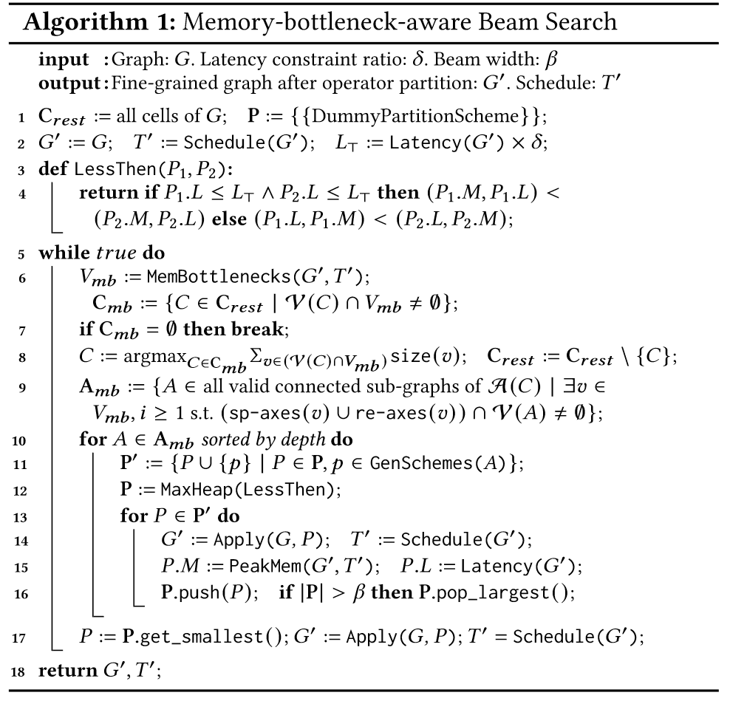
Optimization Algorithm
Select the cell that contributes most to peak memory usage
Select the ACG containing bottlenecks within the cell
Generate partition schemes to build new fine-grained graphs
Measure new graphs and save best-$β$ ones for next iteration.
①
②
③
④
Notes:
With the help of Axis Connecting Graph and based on the insight-2, we design a memory-bottleneck-aware optimization algorithm, which accepts an original graph and a latency constraint ratio as input, searching for fine-grained graph and schedule to achieve lowest peak memory under the given latency constraint. In each iteration, it selects the cell that contributes most to peak memory usage and the Axis Connecting Graphs containing bottlenecks within the cell. Then it generates partition schemes to build new fine-grained graphs and measures the new graphs to save best-β ones for next iteration. And after several iterations within a time budget, it output the fine-grained graph and schedule achieving the lowest peak memory under the given latency constraint.

Slide 17
Evaluation Setup
Tiny Device | SRAM Size
STM32H7A3ZI-Q MCU | 1.4 MB
Baseline | Description
TinyEngine (NIPS’21) | Patch-based Inference for Sequential CNN
HMCOS (DAC’22) | Optimal scheduling for Complicated DNN
Network | Input Size
NASNet-A, DARTS | 32 × 32 × 3 (CIFAR-10)
NASNet-A, DARTS, FPNAS | 224 × 224 × 3 (ImageNet)
MobileNetV2, MCUNetV2 | 224 × 224 × 3 (ImageNet)
BERT-Tiny | 512 × 128
Notes:
Next, we present some of our evaluation results. We conduct experiemnts on an STM32H7 Micro-controller with a 1.4 megabytes memory. As baselines, we choose two open-source projects for memory optimization on tiny devices. TinyEngine uses patch-based inference for sequential CNN memory optimization while HMCOS is scheduling-based method for complicated DNN. Our benchmarks include complicated CNNs, sequential CNNs, and Transformer-based model.

Slide 18
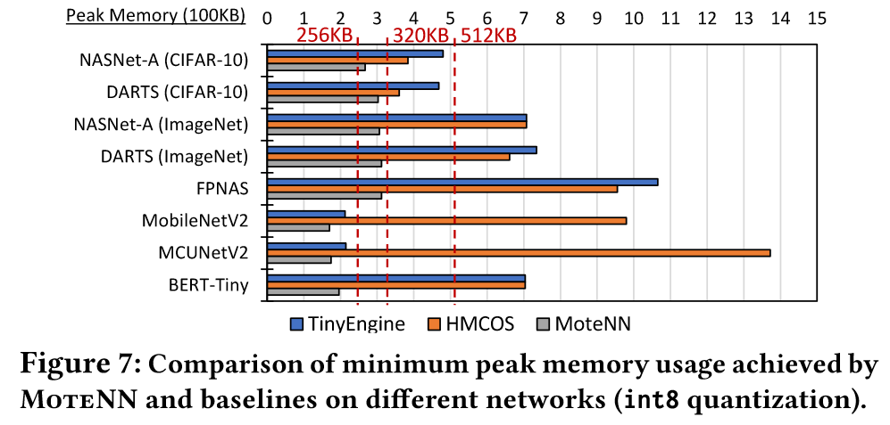
Eval-Results: Peak Memory Usage Optimization
Latency Overhead Constraint: <5%
average 46% (up to 72%) peak memory reduction compared to TinyEngine
average 58% (up to 87%) peak memory reduction compared to HMCOS
Notes:
Here is the evaluation results of the peak memory optimization. For all benchmark networks, We achieve the lowest peak memory usage. We achieve 46% peak memory reduction in average compared to TinyEngine, and 58% peak memory reduction in average compared to HMCOS. And we can optimize all the benchmark networks into 320 kilobytes limit, while other baselines cannot.

Slide 19
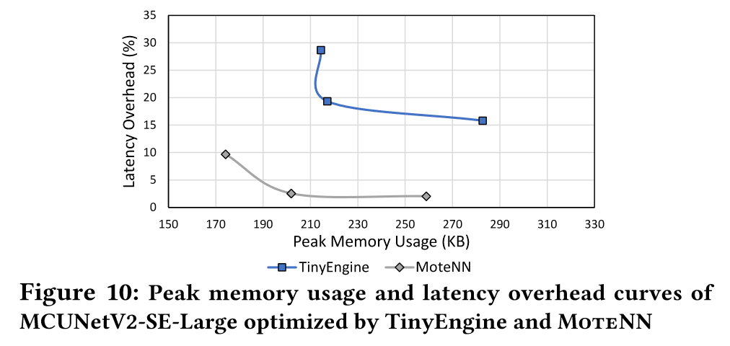
Eval-Results: Full Network Latency Overhead
Better
Pareto Frontier
Notes:
Then we set several latency overhead constraint to compare the peak memory and latency overhead curves of our MoteNN and TinyEngine. We can achieve a better Pareto frontiers compared to TinyEngine, since the patch-based inference used by TinyEngine will introduce large latency overhead due to redundant computations.

Slide 20
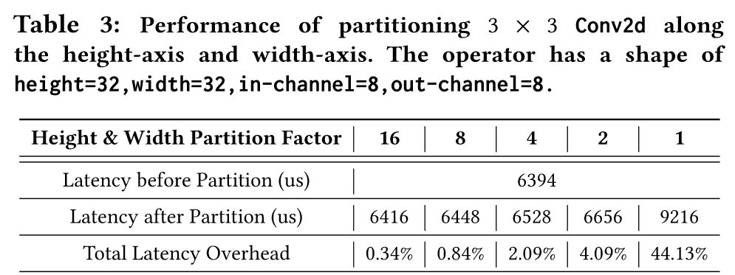
Eval-Results: Single-Operator Latency Overhead
Granularity
Overhead
Notes:
We further test single operator latency overhead with various partition granularity. The results are shown in the table. We can observe that unless the granularity of 1, the latency overheads introduced by operator partition are less than 5%, which is tolerable.

Slide 21
Summary
MoteNN: a DNN memory optimizer using fine-grained scheduling.
A graph representation named "Axis Connecting Graph" (ACG) to model graph-level partition scheme for building fine-grained graph.
An optimization algorithm based on ACG and memory bottleneck to partition and schedule network to reduce its peak memory usage.
Up to 87% peak memory reduction compared to SOTA works with little latency overhead.
Notes:
In summary, we introduce MoteNN: a DNN memory optimizer using fine-grained scheduling. We propose a graph representation named "Axis Connecting Graph" (ACG) to model graph-level partition scheme for building fine-grained graph and an optimization algorithm based on ACG and memory bottleneck to partition and schedule network to reduce its peak memory usage. And we achieve up to 87% peak memory reduction compared to SOTA works with little latency overhead.

